Slide 1
University Project Presentation
AI-Based Multi-Disease Risk Prediction
Using Machine Learning
Predicting Diabetes & Heart Disease Risk with Intelligent Models
Hamza Zafar & Yasal Gandapur
RAHBAR MEDICAL AND DENTAL COLLEGE

Slide 2

Background & Context
Global Health Burden: Diabetes and heart disease cases are increasing rapidly worldwide.
Early Detection: Timely identification is the key to reducing long-term complications.
Accessibility Issues: Many healthcare settings lack expensive, advanced diagnostic tools.
The AI Solution: Machine Learning can assist clinicians by using simple, routine patient data.

Slide 3
Project Objectives
Model Development
Clinical Integration
To develop machine learning models capable of predicting the risk of:
Utilizing simple and non-invasive clinical parameters for easy screening:
Diabetes Risk
Heart Disease Risk
Age, BMI, Blood Pressure, and Glucose levels.

Slide 4



Dataset Source and Sample Size
Sample Size
Legal & Ethical Statement
Diabetes Dataset: ~768 samples
Heart Disease Dataset: ~920 samples
Data used is publicly available
No private or patient-identifiable data is used
Complies with ethical data usage standards
Data Source
Kaggle — Public medical datasets repository
UCI Machine Learning Repository — Trusted research datasets
"All datasets used in this study are publicly available and used strictly for academic and research purposes."

Slide 5
Data & Key Features
We utilized two comprehensive medical datasets for model training:
Diabetes Dataset: Focused on glucose and metabolic indicators.
Heart Disease Dataset: Focused on BP and cardiovascular features.
Selected Features: BMI, Glucose, Insulin, Blood Pressure, and Age.

Slide 6
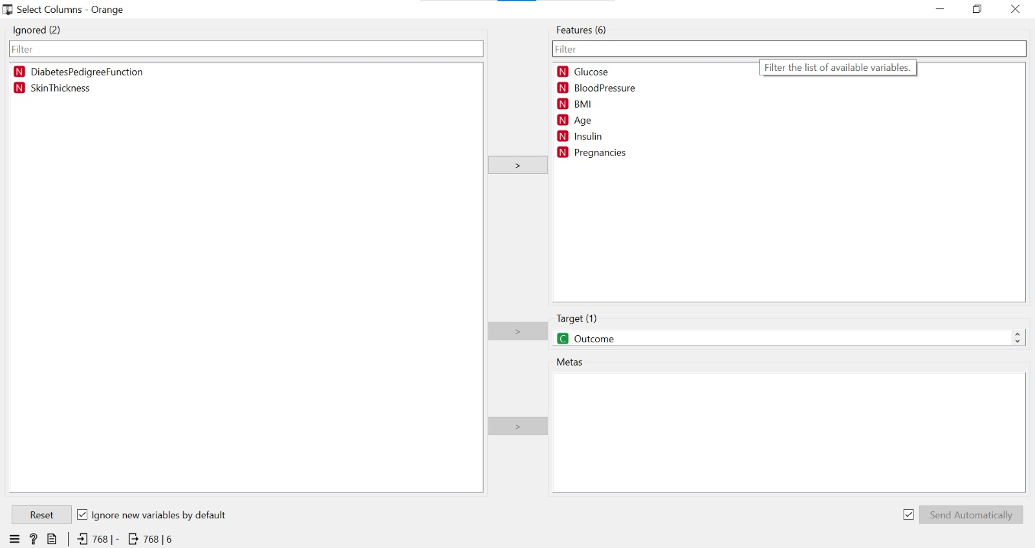
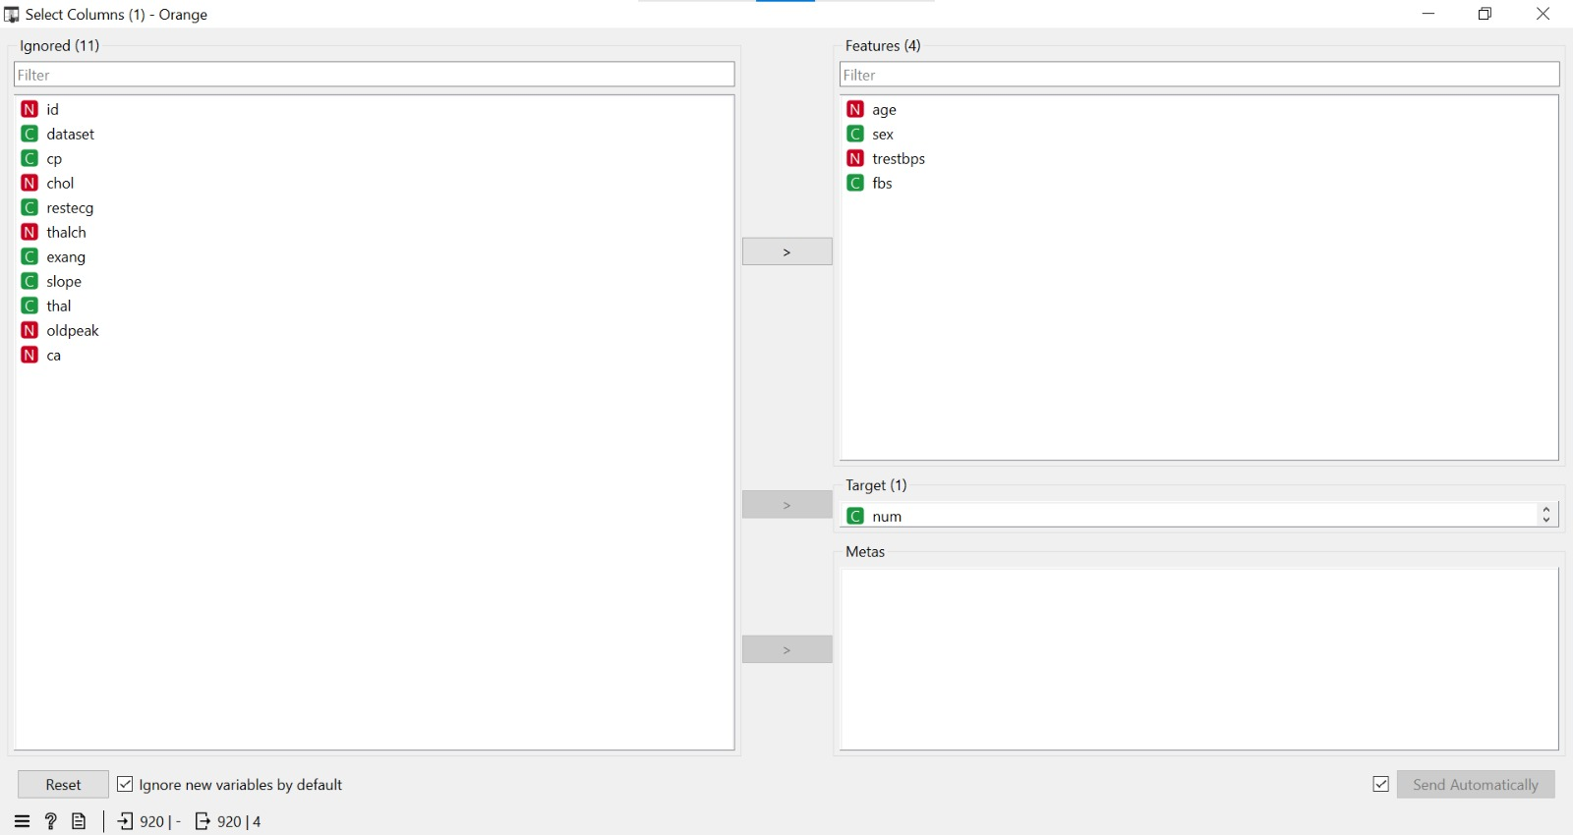
Data Preprocessing
Feature Selection: Removed unnecessary variables to reduce noise.
Clinical Focus: Selected vital features most relevant to diagnosis.
Diabetes Dataset
Heart Disease Dataset
Target Definition: Defined binary target variables (Disease vs. No Disease).

Slide 7
Machine Learning Models
📈
🌲
Logistic Regression
Random Forest
A simple yet powerful statistical model used for binary classification tasks. It serves as our baseline model for performance comparison.
An advanced ensemble model that uses multiple decision trees to improve prediction accuracy and handle complex data relationships.

Slide 8
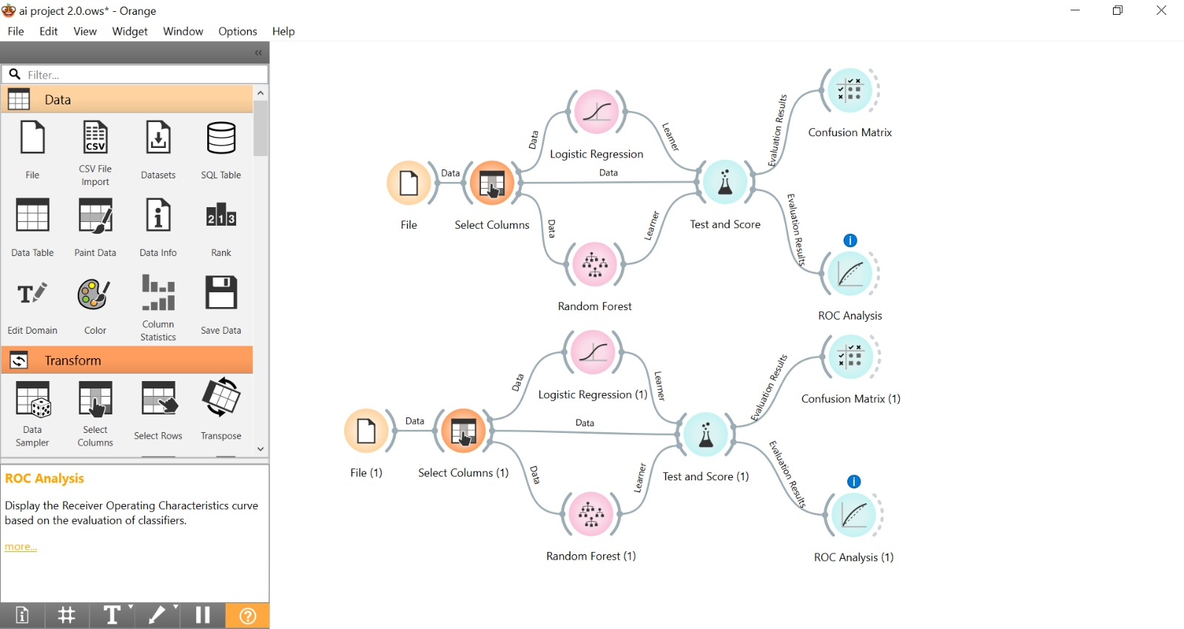
Operational Workflow
Our workflow follows a systematic pipeline to ensure reliable results:
Data Input: Feeding patient clinical parameters.
Learning: The model identifies patterns between features and disease outcomes.
Evaluation: Testing accuracy using real-world clinical benchmarks.

Slide 9
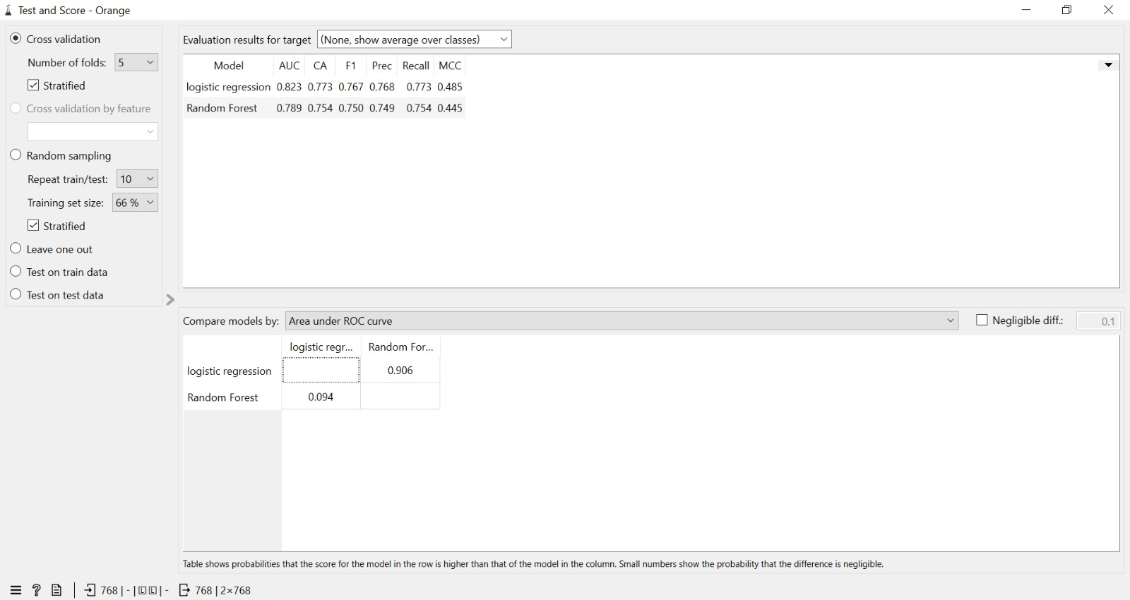
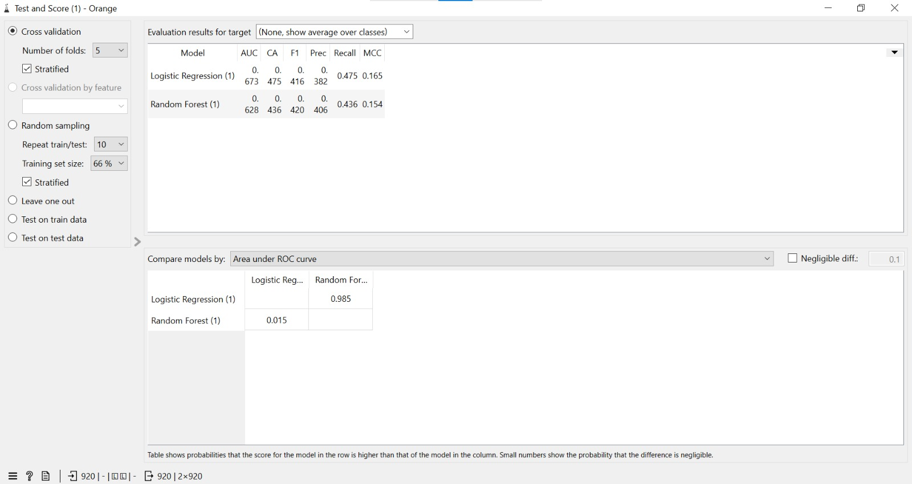
Key Performance Metrics
Classification Results
Logistic Regression: ~67% Accuracy
Random Forest:
~62% Accuracy
AUC Range:
0.62 – 0.67
"In this specific case, Logistic Regression performed slightly better than the advanced ensemble model."

Slide 10
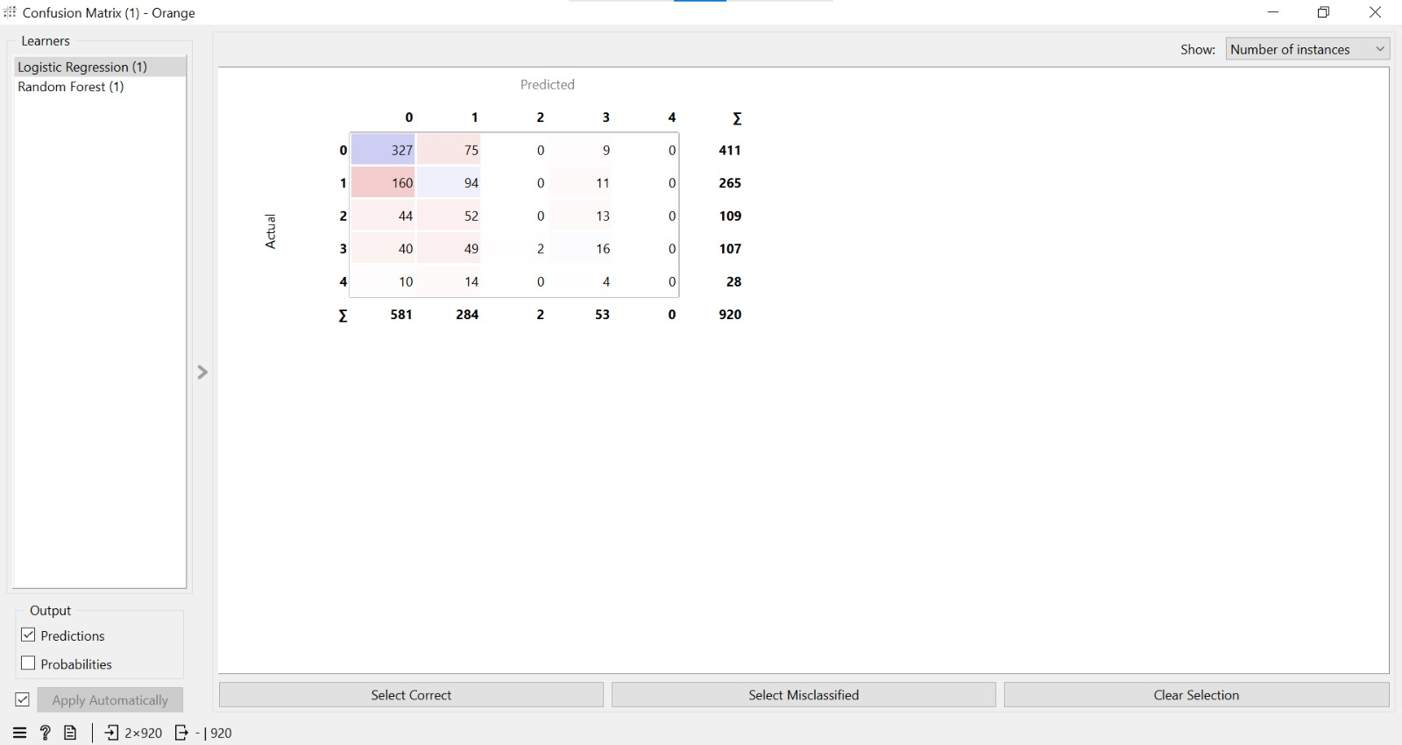
Confusion Matrix: Multi-Class
Category Mapping: The model predicts across multiple health categories.
Correct Hits: Visible on the diagonal of the matrix.
Observations: Shows moderate performance with some misclassifications between adjacent risk levels.

Slide 11
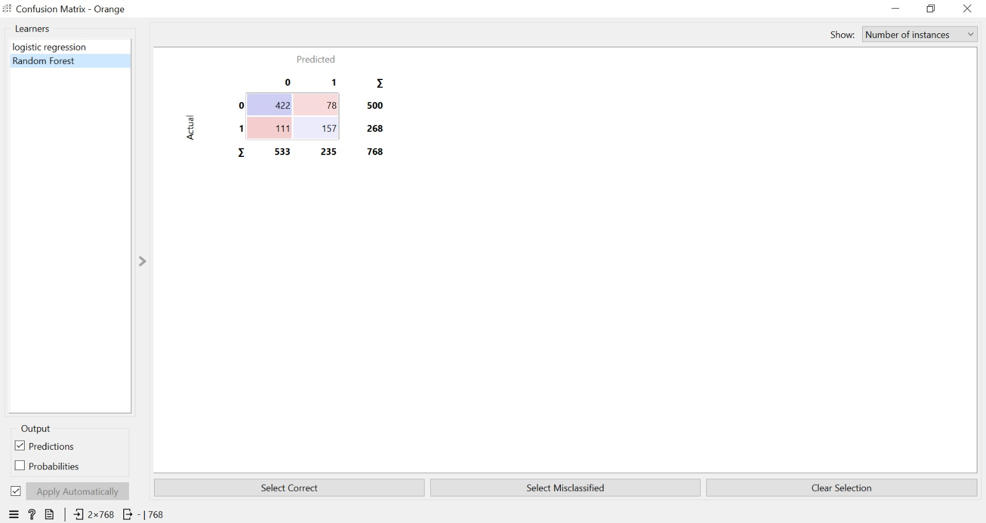
Confusion Matrix: Binary Model
Prediction Breakdown
True Negatives (No Disease): 422
True Positives (Disease): 157
Error Analysis: Some false positives and false negatives exist.
The model performs reasonably well but requires further tuning for clinical perfection.

Slide 12
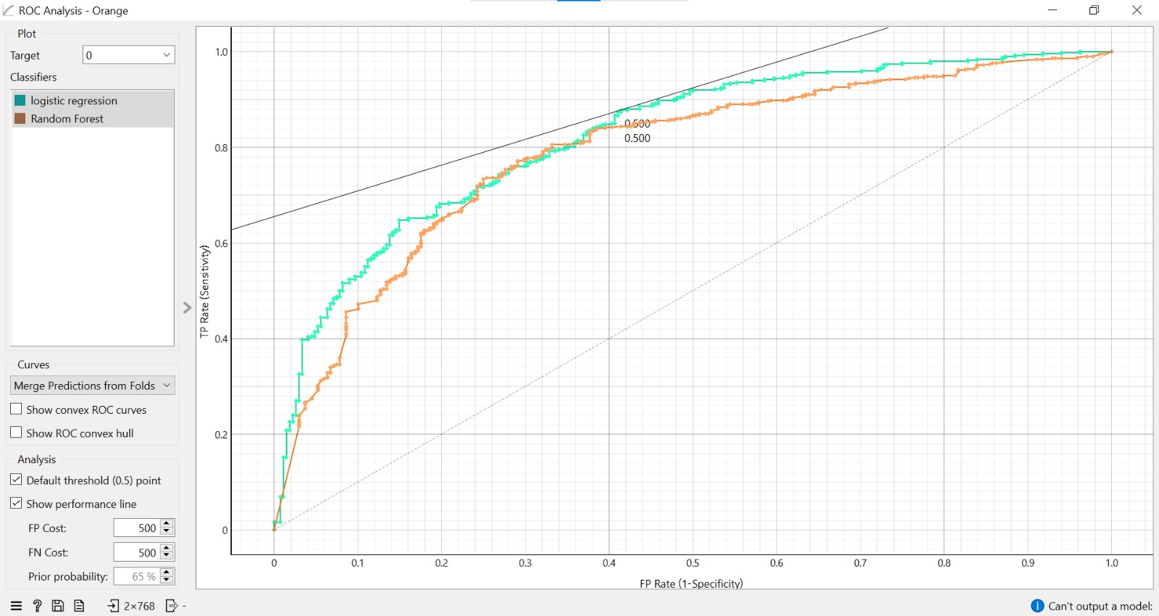
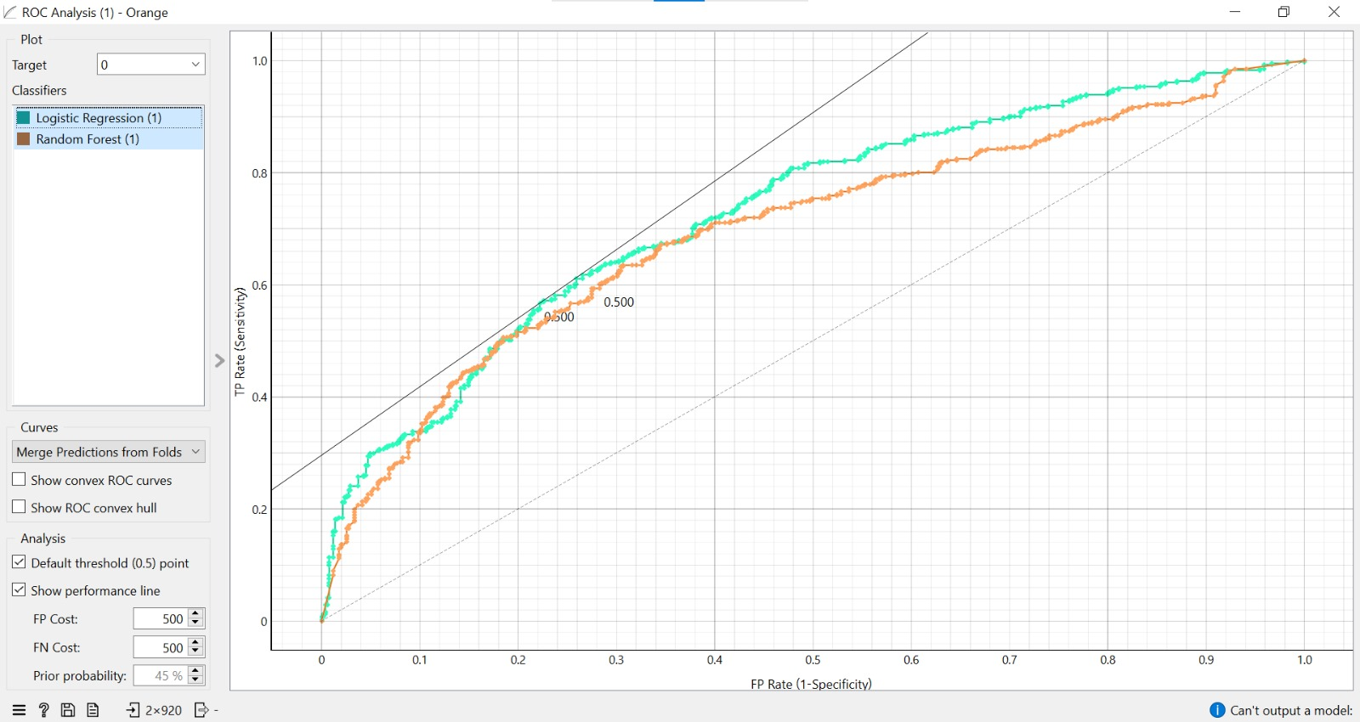
ROC Curve Analysis
The Receiver Operating Characteristic (ROC) curve evaluates the model's sensitivity vs. specificity:
Above Diagonal: Curve stays above the 0.5 threshold, indicating better-than-random prediction.
AUC (0.62–0.67): Acceptable but moderate predictive performance.

Slide 13
Result Discussion
Feasibility: Proves that models can work with very simple clinical data.
Performance: Results are moderate, showing the complexity of medical diagnosis.
Data Constraints: Final accuracy is heavily dependent on the quality and size of the training dataset.
Key Takeaway: Improvements in data preprocessing and cleaning can significantly boost accuracy.

Slide 14
Conclusion
🤖
⏰
🩺
Capability
Early Action
Simplicity
Machine Learning can effectively predict disease risk from routine parameters.
Highly useful as an early screening tool to prevent severe complications.
Works with basic clinical data, making it accessible for basic health centers.

Slide 15
⚠️
"This model is for screening purposes only and is not intended for final medical diagnosis."
CRITICAL DISCLAIMER

Slide 16
The Path Forward
📦
✨
📱
Larger Data
Advanced Tuning
Real-time App
Incorporate diverse and larger patient datasets for better generalization.
Apply Deep Learning or Hyperparameter tuning to boost AUC scores.
Develop a mobile or web application for real-time risk assessment.

Slide 17
Thank You!
We appreciate your attention during this presentation.
Questions?

